Slide 1
Environmental Health Division
Imperial County Public Health Department
Point of Entry Pilot Project
Phase III
Visit Our Website
https://www.icphd.org/environmental-health/point-of-entry-pilot-project/

Slide 2
Introduction
-Project started in 2019
-A total of 46 systems have been installed to date
-Funding for Phase I was from the County PH and IID, while Phase II was a S.E.P. from the IID
-Project consists of installation, monitoring and maintenance, and education
-POE's achieve a 97% success rate in removal of harmful bacteria
-4.3 million gallons of water has been treated through the POE Project
-Installed systems at only income-eligible households
-There is NO COST to residents
-Systems installed throughout the Valley, from Calexico to Niland
-Residents become owners upon completion of two-year program

Slide 3
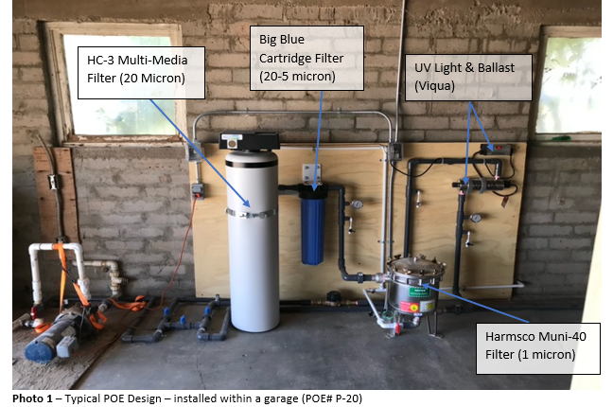

Slide 4
Why is this program important?
Provide residents with safer water
Improved water quality standards.
Maintaining quality through system monitoring and maintenance.
Improve the quality of life and health of our community with equity.

Slide 5
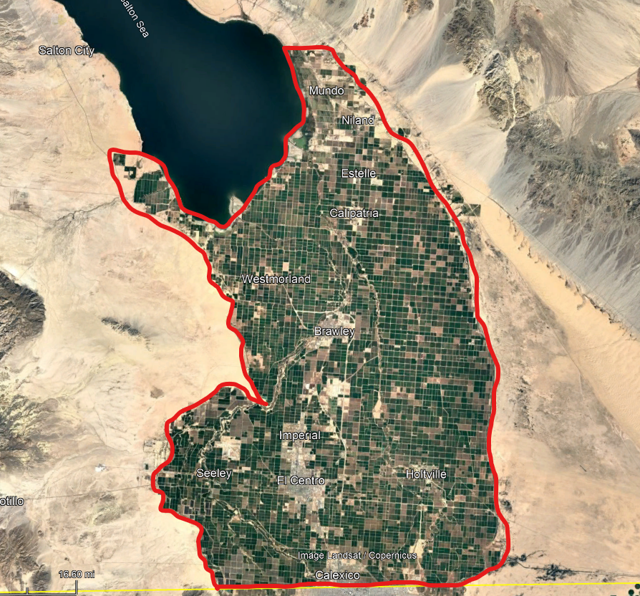
Target Audience
Household not served by a public water system.
Canal water users that reside in Imperial Valley, that are not connected to a public water supply.
Residents throughout the entire Valley

Slide 6
Who is Eligible?
The household is within a community where the Median Household Income (MHI) is less than 80% of the statewide annual MHI level.
Income Level: The household income is less than 200% of the federal poverty level.
Qualifying-Income Program Participation: The household participates in another qualifying-income program that meets the eligibility measures, including, but not limited to:
California Alternative Rates for Energy (CARE)
WIC
Cal-Fresh
Medical
Disability (long-term)
REAP (IID)
SCHIP
CalWorks

Slide 7
How to Enroll?
Application: Complete application (electronically submitted, no hardcopies)
Verification of Income Eligibility: Provide proof of income eligibility income self-certification form.
Homeownership Confirmation: Submit proof of homeownership through utility bill, mortgage or other documentation confirming homeownership (e.g Deed). Or if renting, submit Lease Agreement and Homeownership Declaration.

Slide 8
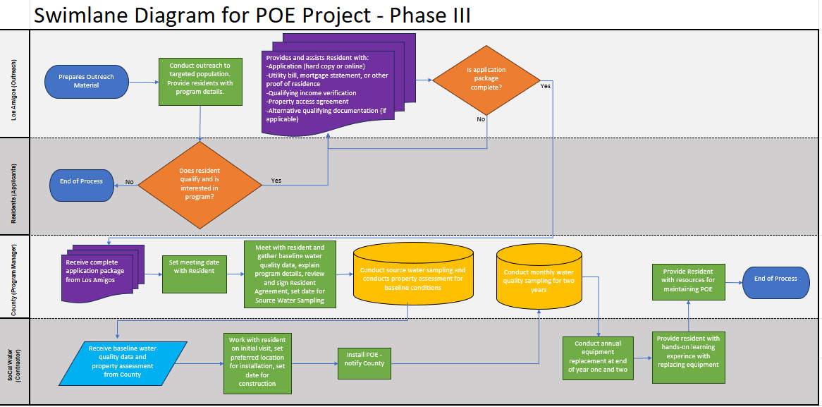

Slide 9
POE Resources
POE Equipment Replacement Video: "How to Maintain your POE System"
POE Maintenance Manual
POE Water Quality Data: POE Dashboard
POE Online Application

Slide 10
EHD Project Team
Jorge A. Perez – jorgeperez@co.imperial.ca.us
Env. Health Services Manager
Sheila Vasquez – sheilavasquezbazua@co.imperial.ca.us
Env. Health Compliance Specialist II
Felipe Vega – felipevega@co.imperial.ca.us
Env. Health Compliance Specialist II

Slide 11
Contact Us
If you have any questions, please feel free to contact us:
442-265-1888
https://www.icphd.org/
797 Main Street, Suite B, El Centro, CA

